Slide 1

Pester Unit Testing is Not Scary
You can do this!
Adam Bertram
Microsoft Cloud and Datacenter Management MVP
@adbertram www.adamtheautomator.com
Notes:
Hello, this is Adam Bertram and this is Infrastructure Testing with Pester. I’m excited to get into this course because this is a topic I’ve been focused on for some time now and has literally changed the way I write my code. Writing test code has not only made me a better coder but has also me (and others) to trust the code that we create actually does what it’s supposed to. This is Module 1: Introduction to Testing. In this module, we’re going to cover the scenario we’ll be working through and giving you a sense of what this testing thing is all about.

Slide 2

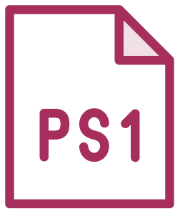
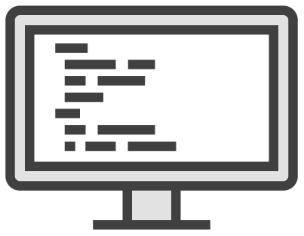

Unit Tests
Test code execution ONLY
Does not touch the environment
Specific to the language
Fast!
Notes:
You’re a studious one. I know this and you’re probably going to look for other ways to learn more about Pester. And, because of that, you’re going to see a lot more examples of unit testing out there with Pester. We’re not going to cover much unit tests at all but you still need to understand how they relate to the kind of testing we’ll be working with.
Unit tests test code execution only. Unit tests don’t actually care if the script created a user, deleted a file or that API you queried actually did what you wanted. They just test that your code executed as you expected.
They don’t touch the environment in any way at all. This is where mocking come into play which we’ll cover a little in a minute.
They are specific to each language. Since they test actual code, they are going to be different for every language. In our case, we’re using PowerShell with Pester.
Finally, they’re lightning fast. Since they don’t have to worry about disk, storage or network latency, they are just executing code on the local CPU and that’s fast.

Slide 3
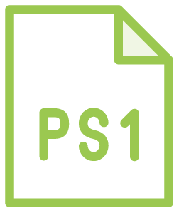
An Example Unit Test
New-AdUser
–Name
adammmm
–Department
Accounting
Unit Test
New-AdUser
FAIL
–Name adam –Department Accounting
X
✔
Execution
X
✔
Notes:
Here’s one of the smallest unit tests you’ll find. I’m executing New-AdUser to create an Active Directory user.
This is a PowerShell script with a reference to New-AdUser. You can see I’m creating a single user and want that user to be in the accounting department.
Now, I’ll build the unit test and define what name and dept will be passed to New-AdUser. Speaking of New-AdUser…
...notice that inside of the actual unit test is a reference for New-AdUser. The test is calling the exact same command that’s in our script. You’ll see that this differs for every test we create.
Let’s now execute our script which contains that New-AdUser reference and check it against our unit test.
It looks like we did pass the word Accounting to New-AdUser so that passes. Now let’s check the Name.
Ouch, it looks like the code did not use the right name parameter so...
...the entire test fails.

Slide 4
Understanding unit testing
Testing a function, script and a DSC class-based resource

Slide 5
Get the Goods
http://bit.ly/devopscamp

